Slide 1
Team-
Kriti MIShra(lead)
Kajal Gyanchandani
Priyanshu Patel
Adarsh Navneet Sinha
THEME-
Environmental Issue
PROJECT-
Waste-Bin

Slide 2
Problem Statement
Design a smart waste collection system that allows citizens to segregate the various types of solid waste they want to dispose and are willing to do so.

Slide 3
200 million people worldwide are at risk of exposure to toxic waste.
Risk to environment as it adversely affects water, soil and air.
The actual problem

Slide 4
India being a densely populated country, have high risk of its adverse impact of environment.
Some data claim that India is third producer of e-waste in the world, and India produced around 3.2 million tonnes of e-waste in 2020.
Why is it a problem in India?

Slide 5
Collecting the e-waste from the home and rewarding others for the same so that it may increase awareness AMONG PEOPLE, through website .
Description of the project

Slide 6
For Basic Project
Web Development(HTML/CSS/BootStrap5/JavaScript)
DBMS
For Practical Implementation
Android Development
Blockchain
AI/ML(Implemented but not successful)
Technol-ogies to be used

Slide 7
Amount of waste Produced in 2020- 3.2 million tonnes
Worth OF 5 tonnes e-waste – 2.88L
Recycling cost of 5 tonnes – 1.10l
Profit in 5 tonnes – 1.78 L
Profit In 3.2 MT E-waste – 113.92 Billion INR
Source – Times Of India
Scope of the Project

Slide 8
While completing and deploying the project, we were successful to deploy the front-end part, but we couldn't integrate the back-end because of time constraints and we never had such an idea of working on deadlines.
Moreover, the remote work was a back point for us as all of us were beginners and couldn't use GitHub effectively.
We tried integrating Sawo Labs and the machine learning model but the back-end failed and we had to drop out.
Challenges we ran into

Slide 9
Collect e-waste weekly with the help of Nagar Palika vechicles.
Give credit to the owner of the waste for giving it to recycle.
Recycle the waste in relevant industries.
Blueprint of Our Idea

Slide 10
LOGIN/SIGN UP WITH CREDENTIAL WHILE GIVING WASTE
GIVE THE WASTE THE TO THE COLLECTOR VAN AND UPDATE ON WEBSITE.
NO! RETURN BACK
UPDATED CREDITS ON WEBSITE AND WASTE SENT FOR RECYCLING.
WAS THE WASTE WORTH?
YES

Slide 11
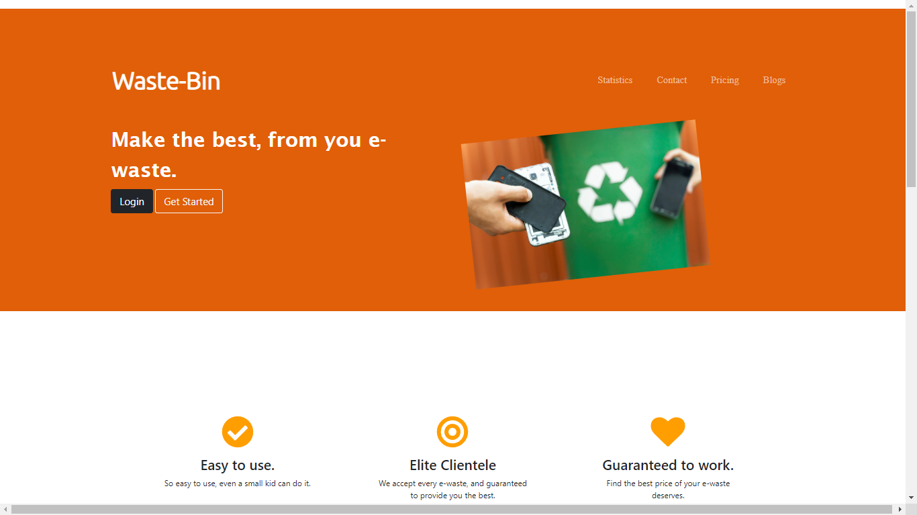

Slide 12
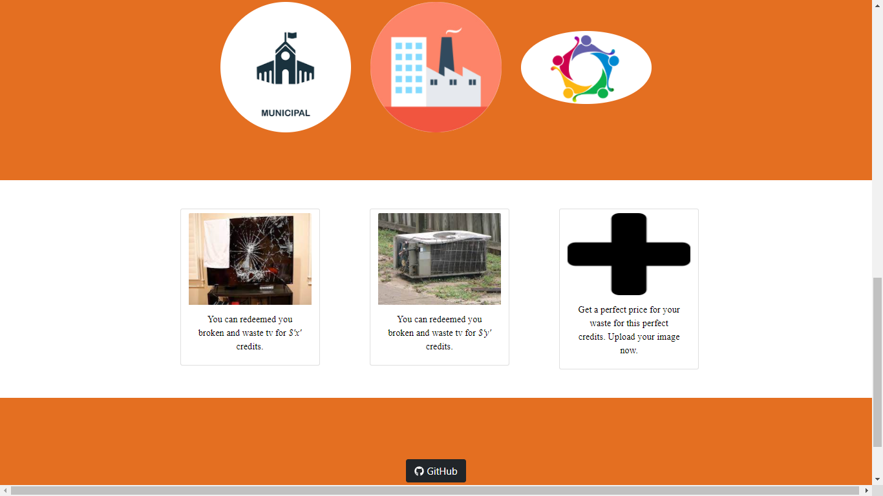

Slide 13
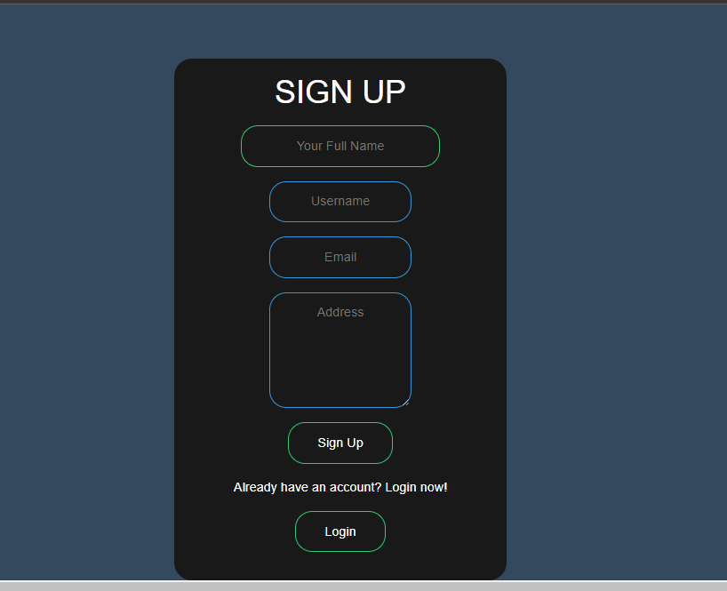
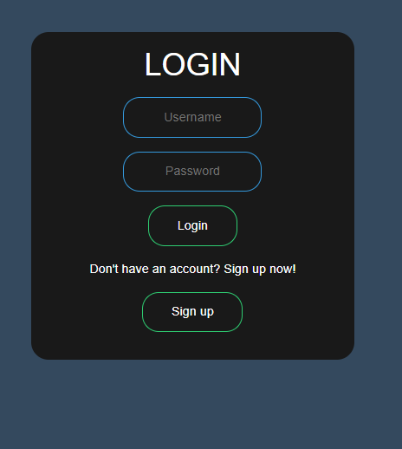

Slide 14
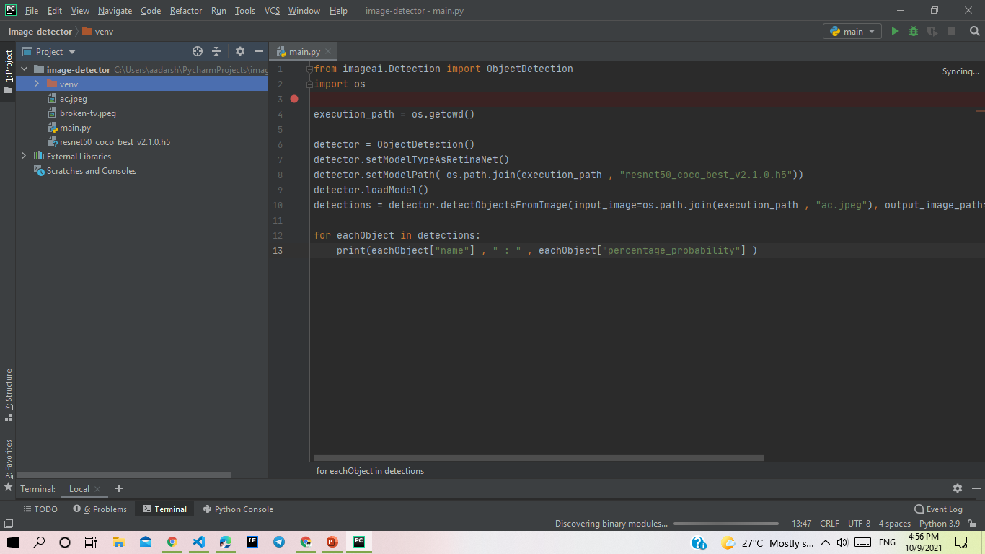

Slide 15
References
Google
Times of India
Towards Data Science
MYGoV

Slide 16
Question time
We are happy to have your questions!!!

Slide 17

Thank You !!!

